Slide 1


Junior Design Project
CSE 299.13(Group-3)
Faculty – Intisar Tahmid Naheen
DONE BY
Asif Anan
Saraf Tasnim

Slide 2
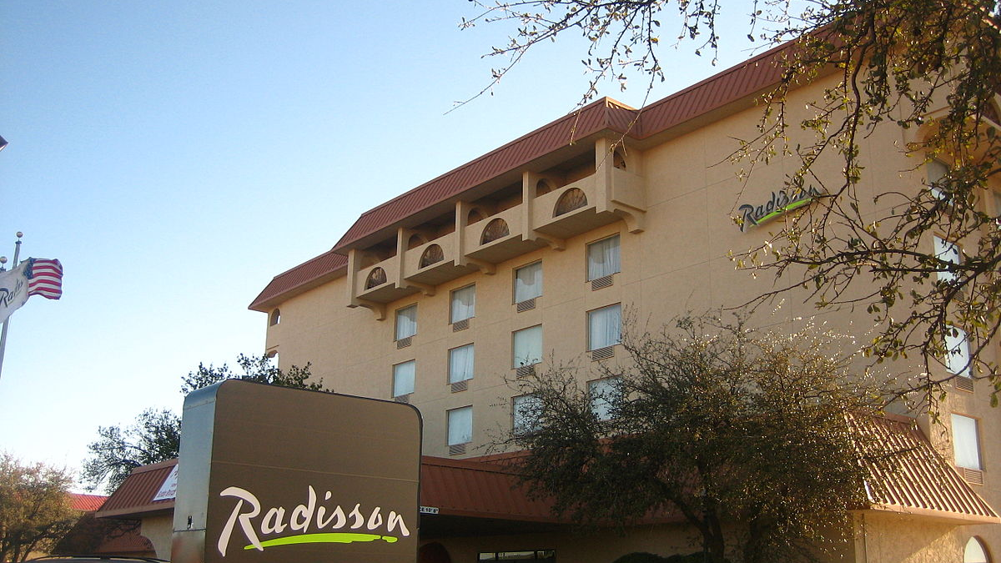

Online Hotel Booking System
.

Slide 3
ABSTRACT
The project “Online Hotel Booking System” is a system based on accessing the internet to book for rooms in a hotel.
The purpose of this study is to develop and implement an online hotel reservation system for hotels, that will replace the manual method of booking for hotel rooms.
The previous system for booking rooms were faced with so many problems like, delay in processing the customer booking or paying for rooms that is below or beyond his standard, causes difficulty for emergency booking.
The use of online view of room rates and uploading of available rooms and facilities was used for the new system so that the customer can view and make his choice before arrival, and also in the case of emergency travelling.

Slide 4
Introduction
This Online Hotel Reservation System is an automated system that allows customers to plan their bookings of a particular hotel. The aim of this system is to keep booking of rooms of a particular hotel.
And the Hotel managers also can see the customer those who booked rooms, can see their details. They can edit hotel room , price , available rooms and details.

Slide 5
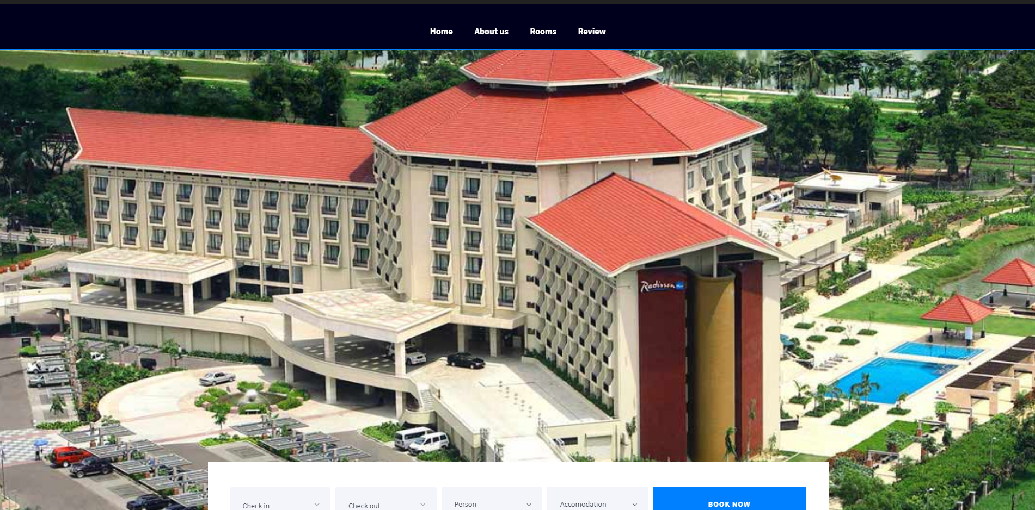

Slide 6
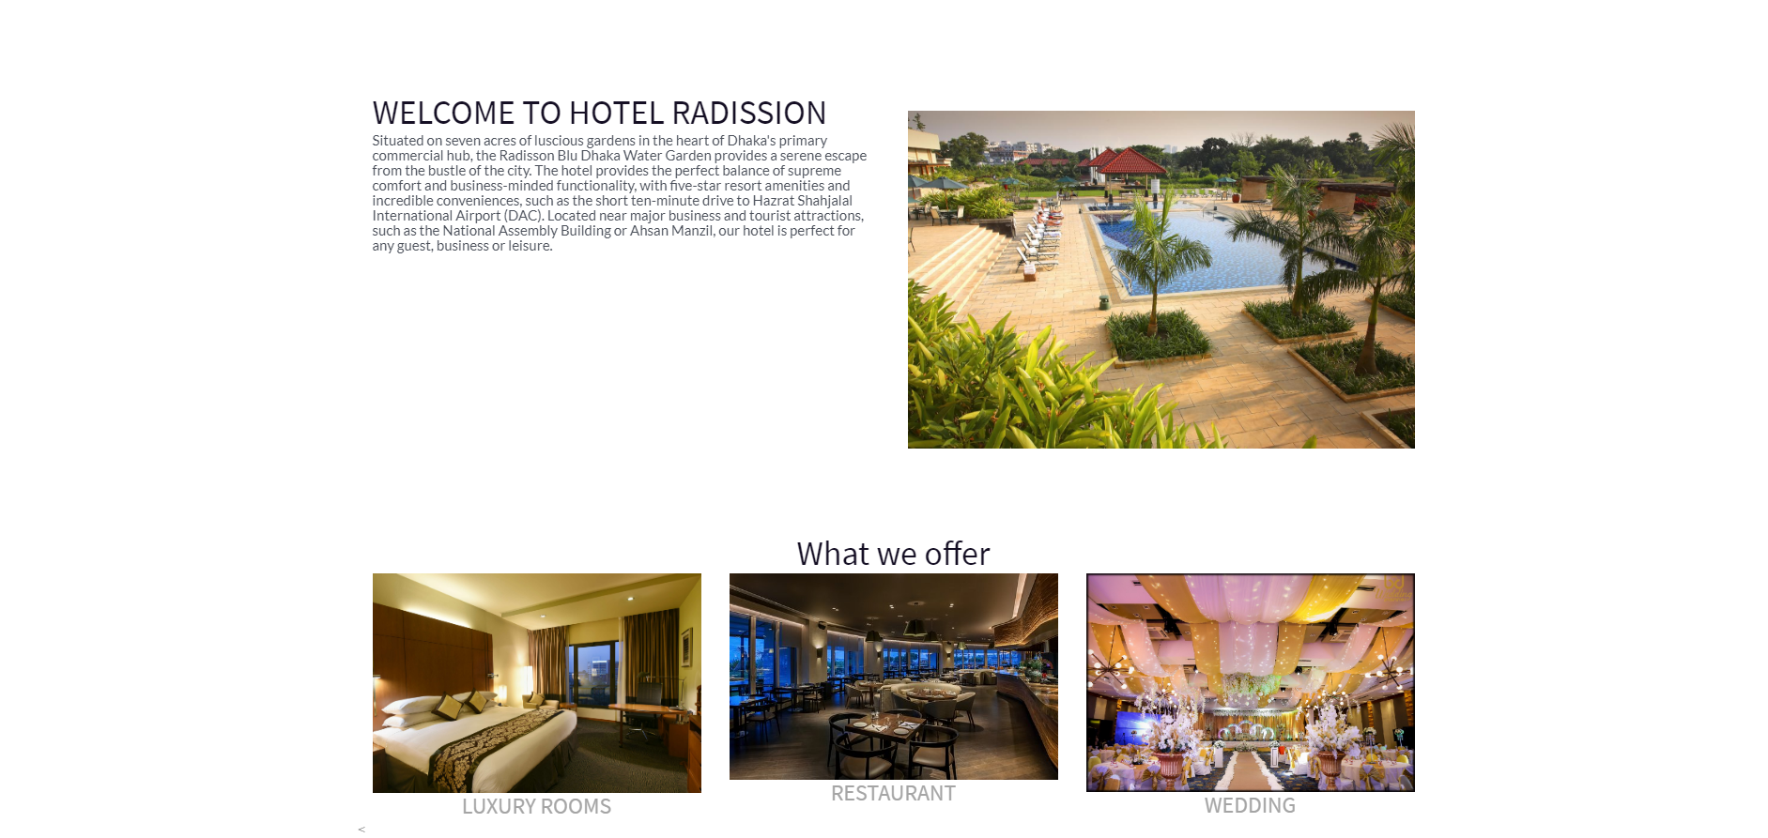

Slide 7
Purpose
It is a beneficial for customers and hotel owners.
Users can get the complete information about the hotel from the Internet.
Easy for customers to find available rooms
Customers can see the details, price and facilities.
Customers can also see the review of that hotel, and also comment about that hotel.
Hotel managers can see the database of the customers .
Hotel managers can view customers details and then confirm their booking.
Hotel managers also can edit the room details, price and facilities.

Slide 8
Scope of study
This study is aimed at finding out how effective the online room reservation or booking system will improve the operations of room reservations in hotels. However, out of the several departments that makes up the hotel, this research project is restricted to only one section ( room reservation) section.

Slide 9
Methodology
Features & Details :
There are two parts :
User view
Admin view

Slide 10
Features & Details
User view means that when a person visit the hotel website they see the hotel web page only. They can also see the hotel details which is given by the admin.
And the another one is admin view. That means that who control the hotel web page. Admin can see how many people book the hotel rooms and see the customers database.

Slide 11
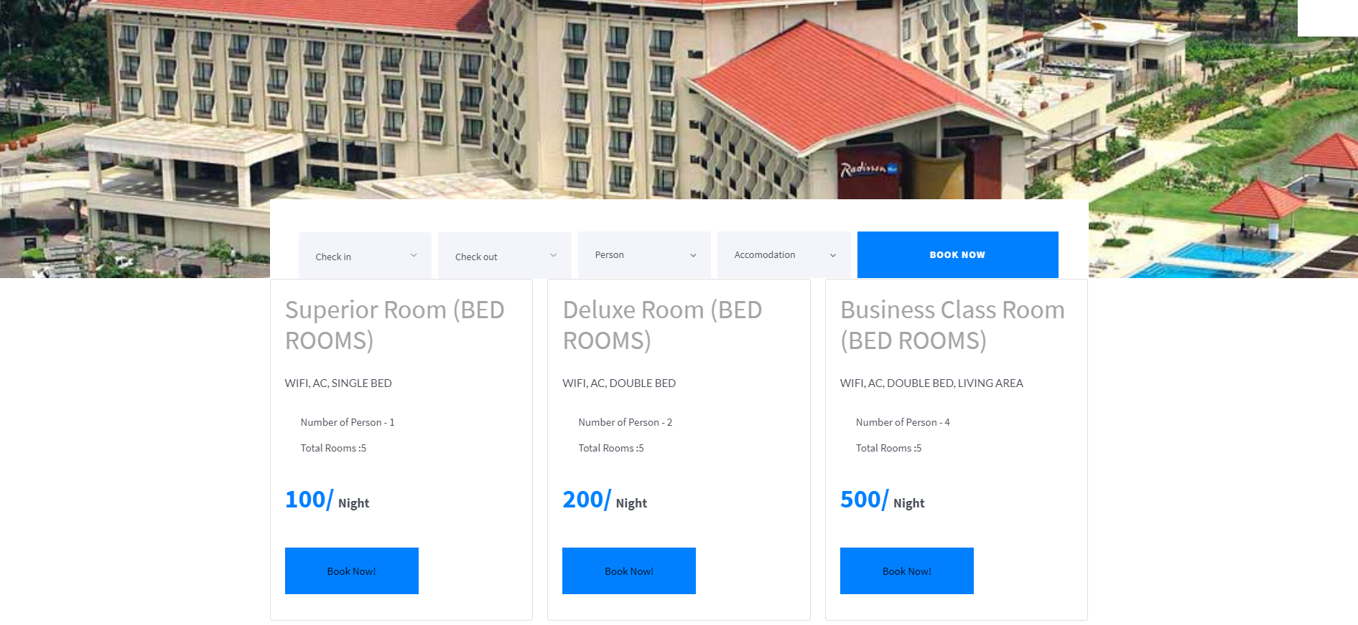

Slide 12
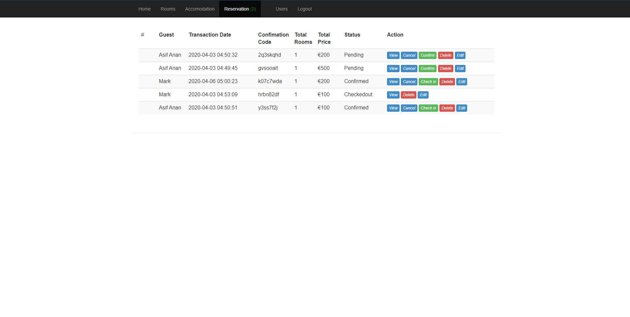

Slide 13


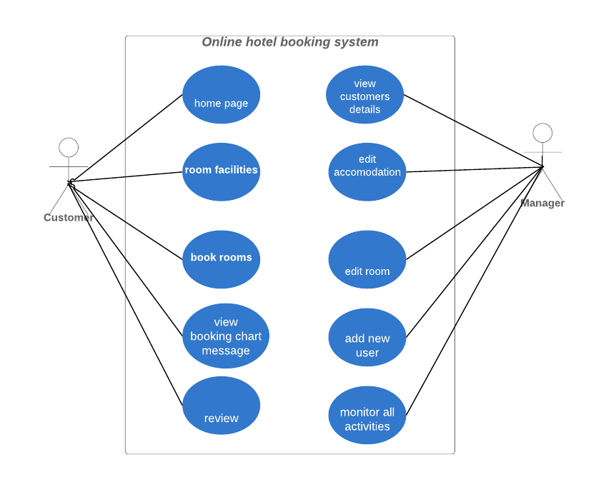
Use case diagram

Slide 14
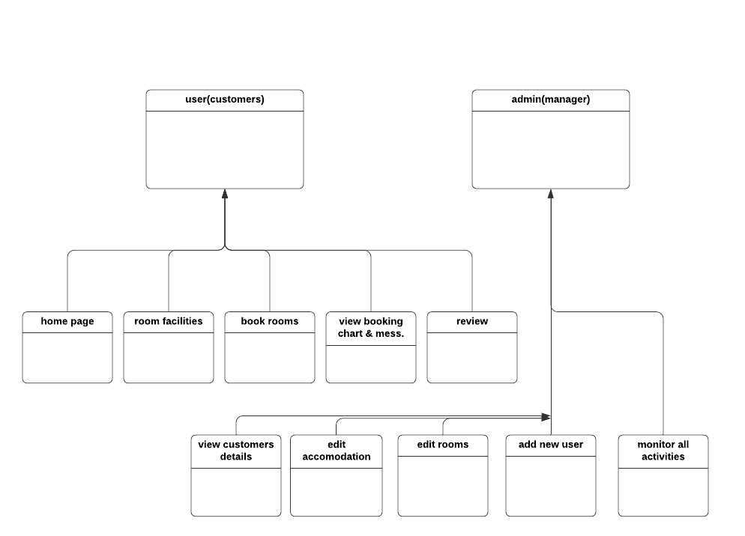
UML Diagram

Slide 15
The Software/Tools we will use
For Frontend we used :
HTML
CSS
BOOTSTRAP
For Backend we used :
PHP
MYSQL

Slide 16
Project Management
GITHUB
TRELLO
SLACK

Slide 17
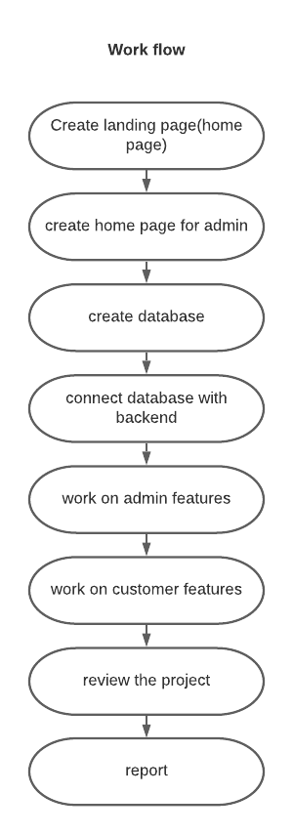
Work Flow
A complete workflow diagram of our work.

Slide 18
Work distribution
Asif Anan | Saraf Tasnim
Report Features- database, connect database with backend, make home page, login for admin, add admin, add rooms, login and reg. for customers, search rooms for user(backend), show rooms, book rooms, reservation action (for admin) (backend), show user booking list (backend & database), Check message(notification) (for user), review (for customer) *Frontend, backend, database (mainly work on backend & database part) | Report Features- create database, create home page for admin, edit rooms, search rooms for user(frontend), login and reg. for user(frontend), reservation action for admin(frontend), show user booking list(frontend) *Frontend, Backend, database (mainly work on frontend part)

Slide 19
Future Scope
There is a lot of opportunities to get better. The project might be changed and upgraded into something progressively delightful and easy to use after some time. In the future, we would also like to add more data to test our database to make it more credible for real-world use. The website may be modified and enhanced into something more beautiful and user-friendly over time.

Slide 20
Conclusion
The system have a great benefits for both customers and admin of the hotel. In home page customers can also share their experience. So, overall this system will give the customers a better user friendly environment to book rooms in online. And it’s easy to use and manage all the activities for hotel admin.

Slide 21
Thank You

